Slide 1


For Beginner
By :- RAHUL JOGRANA
www.dotnetlab.in
www.aspnetinhindi.blogspot.com
Twitter:- @thejograna
Github:- github.com/rahuljograna
Part 6 Buttons in ionic

Slide 2

Buttons in ionic
Buttons are an essential way to interact with and navigate through an app, and should clearly communicate what action will occur after the user taps them. Buttons can consist of text and/or an icon, and can be enhanced with a wide variety of attributes.
For accessibility reasons, buttons use a standard <button> element, but are enhanced with an ion-button directive.
https://ionicframework.com/docs/components/index.html#buttons

Slide 3

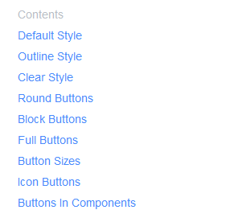


Buttons in ionic

Slide 4
Let’s start

Slide 5
To learn new Technology along with Example like
ASP.NET, ASP.NET MVC, AngularJS, ASP.NET Web API
From Beginners visit my Youtube channel and steps and Source code is
Available on My Blog and Web site
To Get notification for new updates Subscribe my YOUTUBE Channel.
Source Code :- http://aspnetinhindi.blogspot.com
Website :- http://www.dotnetlab.in
Github :- https://github.com/rahuljograna
Twitter :- twitter.com/thejograna
Mail :- rahuljograna007@gmail.com
WhatsApp Number :- 9426585554

Slide 6
To Develop Application
Contact me
Mail me : rahuljograna007@gmail.com
Mobile : +91 9426585554
whatsApp : +91 9426585554

